Slide 1
IBM University Engagement Project Submission
“Exploring the Power of Agentic AI with IBM Cloud and Orchestrate”

Slide 2
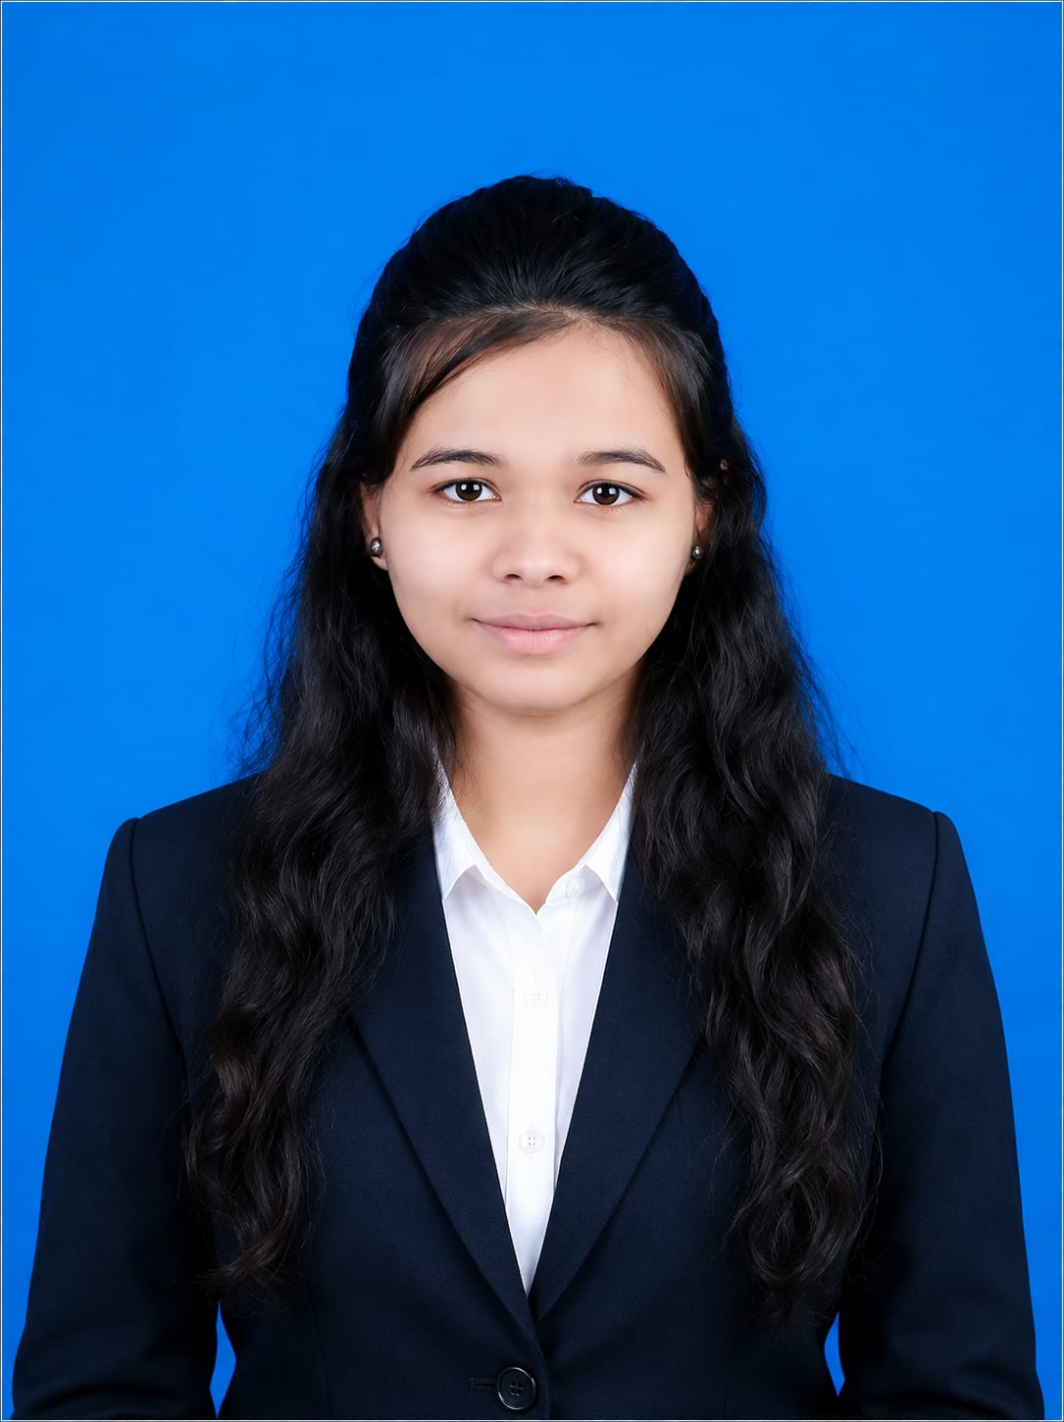
Project Title – [Research Agent]
Domain of Project – [ Smart Research Agent ]
Student Name | Recent Passport Photo | Email ID | Mobile number [WhatsApp]
Rasika Rajendra Patil |  | rashikapatil2802@gmail.com | 9657126702

Slide 3
Problem Statement -
Problem Statement : Research Agent
The Challenge:
Researchers, students, and professionals often struggle to find relevant information from a large number of research papers, journals, articles, and online resources. Collecting, analyzing, and summarizing information from multiple sources is time-consuming and inefficient. It becomes difficult to identify important insights, research trends, and knowledge gaps. Therefore, there is a need for an intelligent Research Agent that can automatically gather information, analyze data, and provide meaningful research
The Objective:
Collect information from multiple research sources.
Generate automatic summaries of research papers.
Identify research trends and knowledge gaps.
Provide actionable insights and recommendations.
Visualize research findings through an interactive dashboard.

Slide 4
Proposed Solution -
Proposed Solution: AI-Powered Nutrition Agent
The proposed solution is an AI-powered Nutrition Agent that helps users maintain a healthy lifestyle by providing personalized nutrition recommendations. The system analyzes user information such as age, weight, height, dietary preferences, and health goals to generate customized meal plans and nutritional guidance.
The Nutrition Agent can:
Recommend personalized diet plans.
Calculate BMI, BMR, and daily calorie requirements.
Suggest healthy food alternatives.
Track daily nutrition intake.
Provide health and wellness insights using AI.
Answer nutrition-related queries in real time.
This solution helps users make informed dietary decisions and improve their overall health through intelligent and data-driven recommendations.

Slide 5
Technology Used:
• Langflow Platform – Used to create and manage AI agent workflows through a visual drag-and-drop interface.
• IBM Granite Model – Processes user research queries, understands context, and generates accurate summaries and insights.
• IBM Watsonx.ai – Provides tools for developing, deploying, and managing AI models efficiently.
• Research Knowledge Base – Stores research papers, journals, and academic content for information retrieval.
• Vector Database (FAISS/Chroma) – Enables fast semantic search and retrieval of relevant research documents.
• RAG (Retrieval-Augmented Generation) – Combines document retrieval with AI-generated responses for more accurate research results.
• IBM Cloud – Hosts and scales the application while ensuring security and reliability.
• Data Visualization Tools – Used to present research trends, citation analysis, and insights through charts and dashboards.

Slide 6
Orchestrate component Used :-
1)Chat Input – Interface where users enter research topics, questions, keywords, or upload research documents for analysis.
2) IBM watsonx AI Agent – Processes research queries using AI models to understand the context, analyze information, and generate research insights.
3) Name of IBM Granite Model – Granite-4.0-8B-Instruct → Optimized for document analysis, summarization, question answering, and knowledge extraction.
4) Chat Output – Displays AI-generated summaries, key findings, research trends, related studies, and recommendations.
5) File Component – Stores and retrieves research papers, academic articles, reports, and datasets for processing and analysis.
6) Data Storage Component – Maintains research documents, extracted insights, and user activity records.
7) Visualization & Reporting Component – Generates charts, trend reports, and dashboards for better understanding of research outcomes.

Slide 7
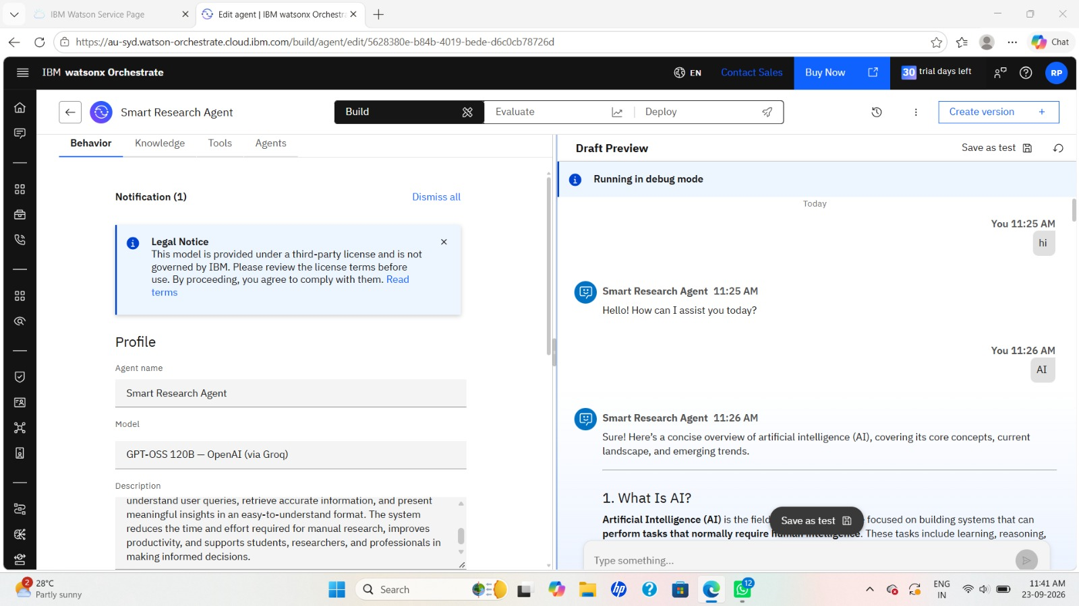
Agent Instructions Screenshot-

Slide 8
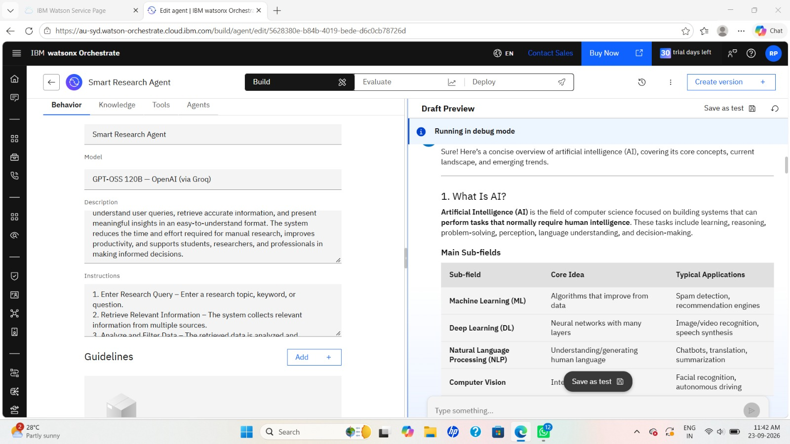
Document Uploaded Screenshot (If applicable)-

Slide 9
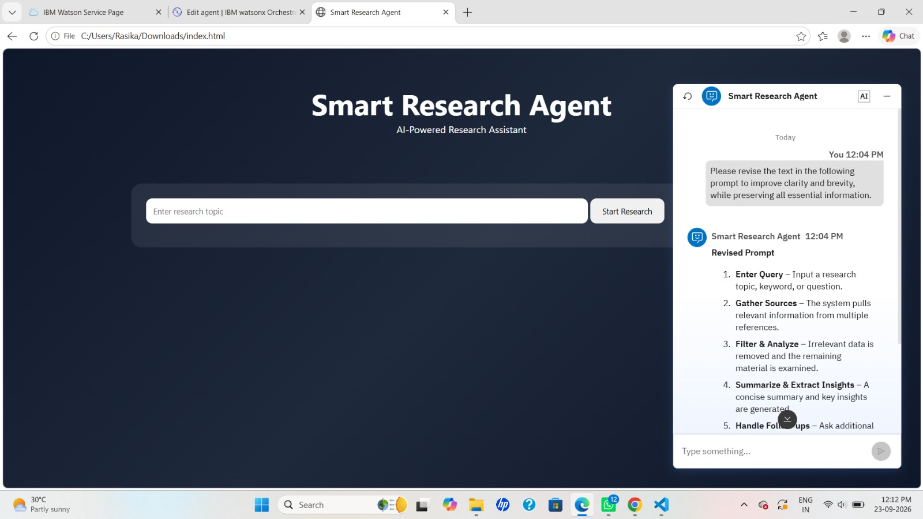
Prompt with output Screenshot:
-Use different slides for multiple screenshots

Slide 10
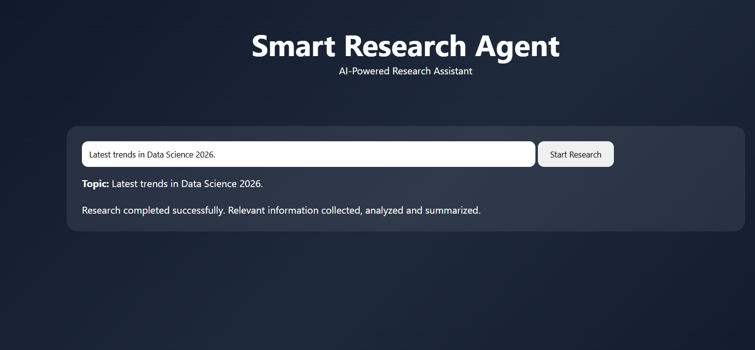
Other Applicable Screenshots:

Slide 11
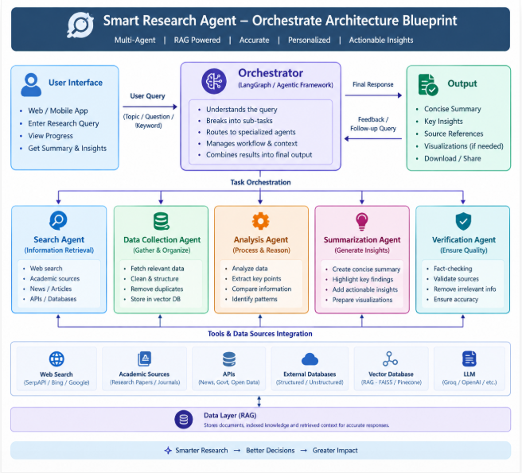
Orchestrate architecture blueprint

Slide 12

Role of Agentic AI in the solution:
Role of Agentic AI in Nutrition Agent:
Agentic AI acts as an intelligent research assistant that can independently perform multiple research-related tasks. It understands user queries, retrieves relevant information from research sources, analyzes documents, generates summaries, and provides meaningful insights. By automating these activities, Agentic AI reduces manual effort, improves research efficiency, and helps users make informed decisions faster.
Agentic AI serves as the core intelligence of the Research Agent. It can independently plan, execute, and manage research-related tasks without requiring constant user intervention. The system gathers information, analyzes content, generates insights, and provides meaningful recommendations.
Example: When a user searches "AI in Healthcare", the Agentic AI automatically retrieves relevant research papers, summarizes key findings, identifies trends, and provides actionable insights.

Slide 13
Novelty and Uniqueness:
The proposed Research Agent stands out by combining Agentic AI, RAG, Multi-Agent Collaboration, and Intelligent Research Analytics into a single platform.
Multi-Agent Intelligence – Multiple specialized agents work together for document retrieval, content analysis, summarization, and insight generation.
RAG-Based Research Accuracy – Combines real-time document retrieval with AI-generated responses, ensuring accurate and evidence-based research results.
Automated Knowledge Discovery – Identifies hidden patterns, relationships, and emerging trends across multiple research papers.
Smart Research Summarization – Converts lengthy academic papers into concise, easy-to-understand summaries.
Research Gap Identification – Detects unexplored areas and suggests potential future research opportunities.
Intelligent Recommendation Engine – Recommends related papers, topics, and references based on user interests and research context.

Slide 14
Git Hub Link
·
·
·

Slide 15
Future Scope:
AI-Powered Research Collaboration – Enable multiple researchers to collaborate, share findings, and work on research projects in real time.
Multi-Language Research Support – Support research papers and queries in multiple languages for global accessibility.
Voice-Based Research Assistant – Allow users to interact with the Research Agent using voice commands and speech-based queries.
Advanced Citation & Reference Management – Automatically generate citations, references, and bibliographies in different academic formats.
Predictive Research Analytics – Forecast emerging research trends and identify future opportunities in various domains.
Integration with Research Databases – Connect with digital libraries, journals, and academic repositories for broader knowledge access.
Personalized Research Recommendations – Suggest papers, authors, and topics based on user interests and previous searches.
Real-Time Research Monitoring – Track newly published papers and notify users about relevant updates and discoveries.
·
·
·

Slide 16
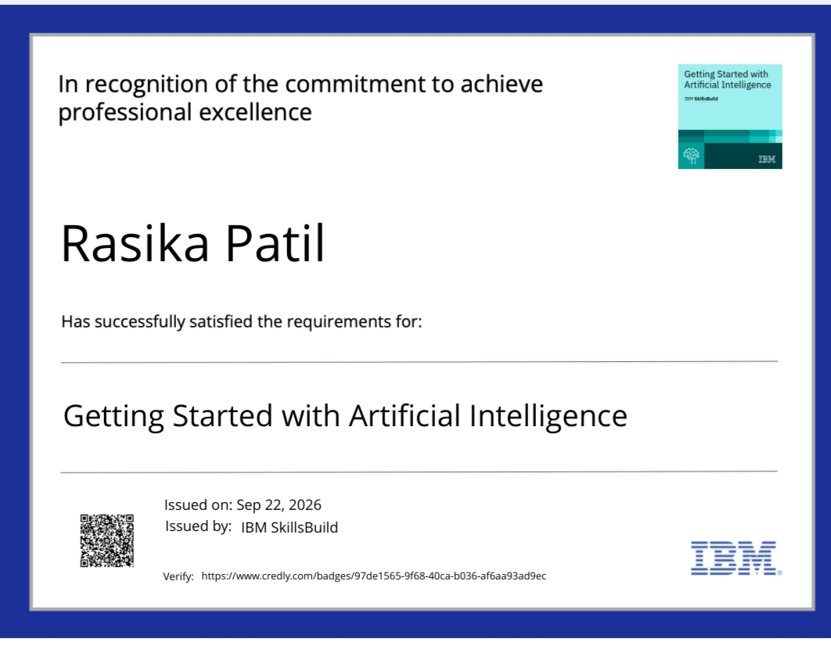
Certificates Earned:
Please add your credly certificate

Slide 17
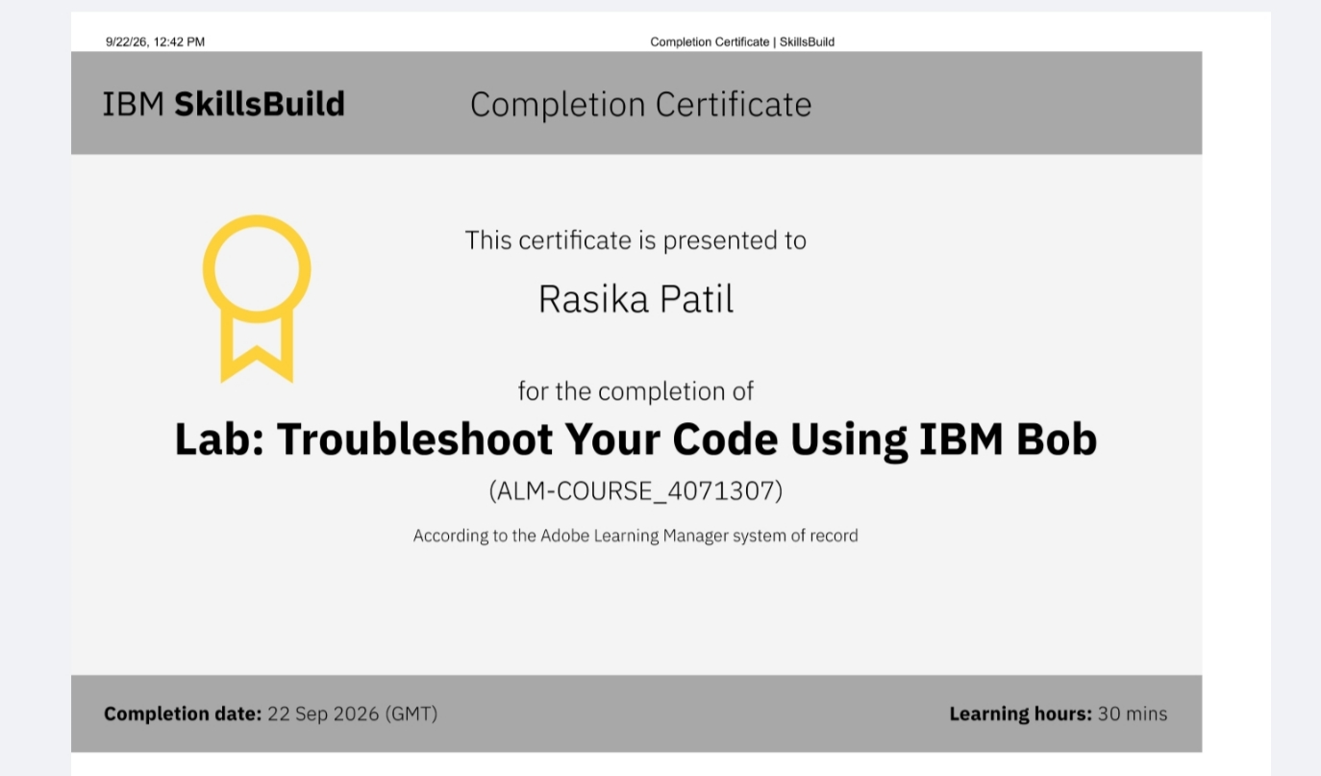
Certificates Earned:​
Add your IBM BOB Certificate

Slide 18


